Slide 1
LINUX
BHAVANA
DAY 4
04/04/2024

Slide 2
The command chmod -R 777 / makes every single file on the system under / (root) have rwxrwxrwx permissions. This is equivalent to allowing ALL users read/write/execute permissions
ls –lt : to check the permission of the file.
: USED TO MATCH ZERO OR MORE CHARECTERS
? : USED TO MATCH EXACTLY ONE CHARACTER
The "file" command tells us what type of file it might be text, executable, PDF, jpg, gzip, tar, directory, etc.
$ file read-write.txt

Slide 3
What is the difference between cp and mv commands?
The ‘cp’ and ‘mv’ commands are both used for file manipulation in Unix-like operating systems, but they serve different purposes:
1. cp (copy):
- The ‘cp’ command is used to copy files or directories from one location to another.
- When you use ‘cp’, the original file remains intact, and a duplicate copy is created in the destination location.
- Example: ‘cp file1.txt directory/’ - This command copies the file `file1.txt` to the directory `directory/`.
2. mv (move):
- The ‘mv’ command is used to move files or directories from one location to another or to rename files or directories.
- When you use ‘mv’, the file is physically moved from its current location to the destination location.
- If you use ‘mv’ to rename a file within the same directory, it effectively renames the file.
- Example : ‘mv file1.txt directory/’ - This command moves the file ‘file1.txt’ to the directory ‘directory/’.

Slide 4
How can you see all the files in a directory, including hidden ones?
ls -a
How can you search for files based on their creation date?
find ~/Documents -type f -ctime -7
What are some basic text editing commands you can use in the terminal?
nano

Slide 5
rm : To remove file
rmdir : To remove a directory
"more" or "less“
$ more mascots.txt
$ less mascots.txt
each prints out a page of a file at a time
"head" or "tail“
$head mascots.txt
prints out the first 10 lines by default. Can use the -n argument to change the default number of lines
$ tail -20 mascots.txt
prints out the last 20 lines

Slide 6
nano a simple editor
$ nano filenameThe
essentials:
▸ Just start typing - can use arrow keys to position, backspace or delete key to delete characters to the left
▸ Keystrokes for basic commands at bottom of the screen
▸ ^G - help screen (^C to exit help)
▸ O-save the file> ^W - search for a string
▸ ^X - exit nano
grep: pattern matching search of a file.
wc :used to find the word count

Slide 7
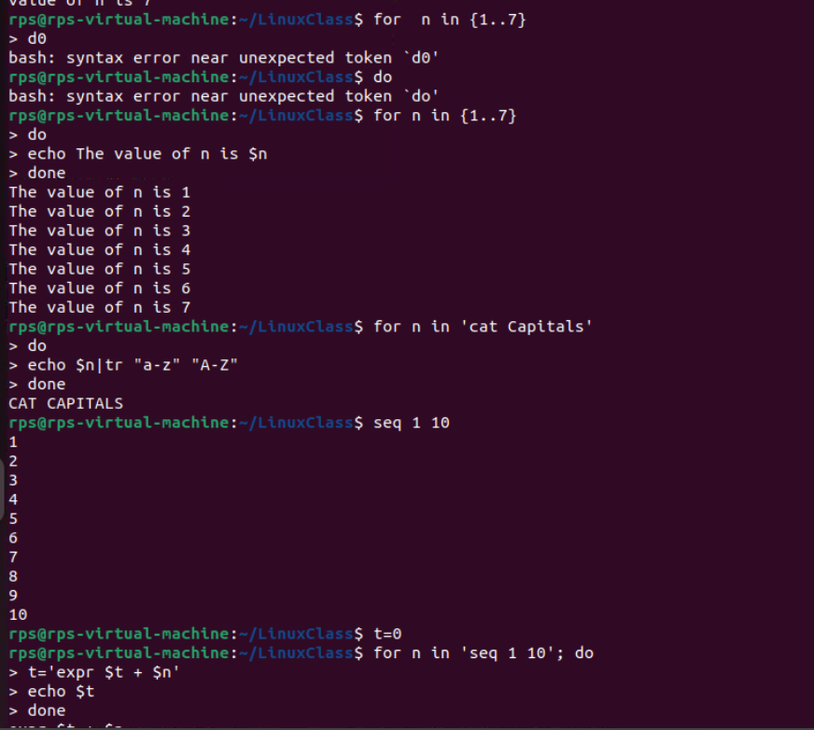
SHELL SCRIPTING:

Slide 8
